Slide 1
WRDS Platform
WRDS Access
Programming at WRDS

Slide 2
Outline
Types of financial data and data vendors
Finding, downloading and using appropriate financial data
WRDS subscription
3 ways to use the WRDS platform

Slide 3
Company Information
CCM
Funds
Security
CRSP
TAQ
Mutual Funds
TASS
HFR
CRSP Mutual
Morningstar
CISDM
Hedge Funds
Equity
COMPUSTAT
Accounting
Derivatives
Optionmetrics
Bonds & Loan
Trace
Thomson 13F
Ownership & Governance
Lionshares
Valuation
I/B/E/S
M&A Restructuring
SDC Platinum
Markit CDS
Capital IQ
Riskmetrics
Worldscope
Thomson 12D
GovPX
ISSM
MFLINKS
Bordex
KLD & GMI
ZACKS
GSI Online
CRSP Treasury
Markit Securities
FactSet
ETF Global

Slide 4
CCM
COMPUSTAT
CRSP
OptionMetrics
Markit
Derivatives Markets
NYSE TAQ
ISSM, GovPX
Market Microstructure
CRSP Mutual Funds
Morningstar Direct
Mutual Funds
TASS , HFR, CISDM
Thomson 13F
Hedge Funds
RiskMetrics, Executive Com
Boardex
Corporate Governance
SDC Platinum
GSIOnline
M&A Markets
IPO Markets
IBES
Zacks
Analysts
Capital IQ
Factset
Capital Structure

Slide 5
How to get necessary data
Most data are available from the WRDS
Some data can be extracted from some commercial data vendors
SDC Platinum
Datastream
Bloomberg
Morningstar Direct
Nanex
Exchanges (CBOE, CME, ….)

Slide 6
Data from the WRDS
WRDS stands for Wharton Research Data Service
WRDS aggregates and standardizes financial data into a standard format and makes it to subscribers
WRDS is a single destination for many of the leading databases
WRDS is Internet-based with multiple access options
Web queries : easy-to-use, point-and-click interface
PC SAS CONNECT remote libraries
UNIX X-Window and batch job power

Slide 7
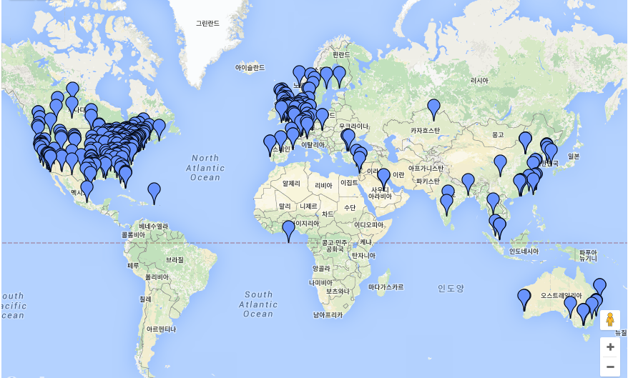
Map of WRDS subscribers

Slide 8
Where?
https://wrds-web.wharton.upenn.edu

Slide 9
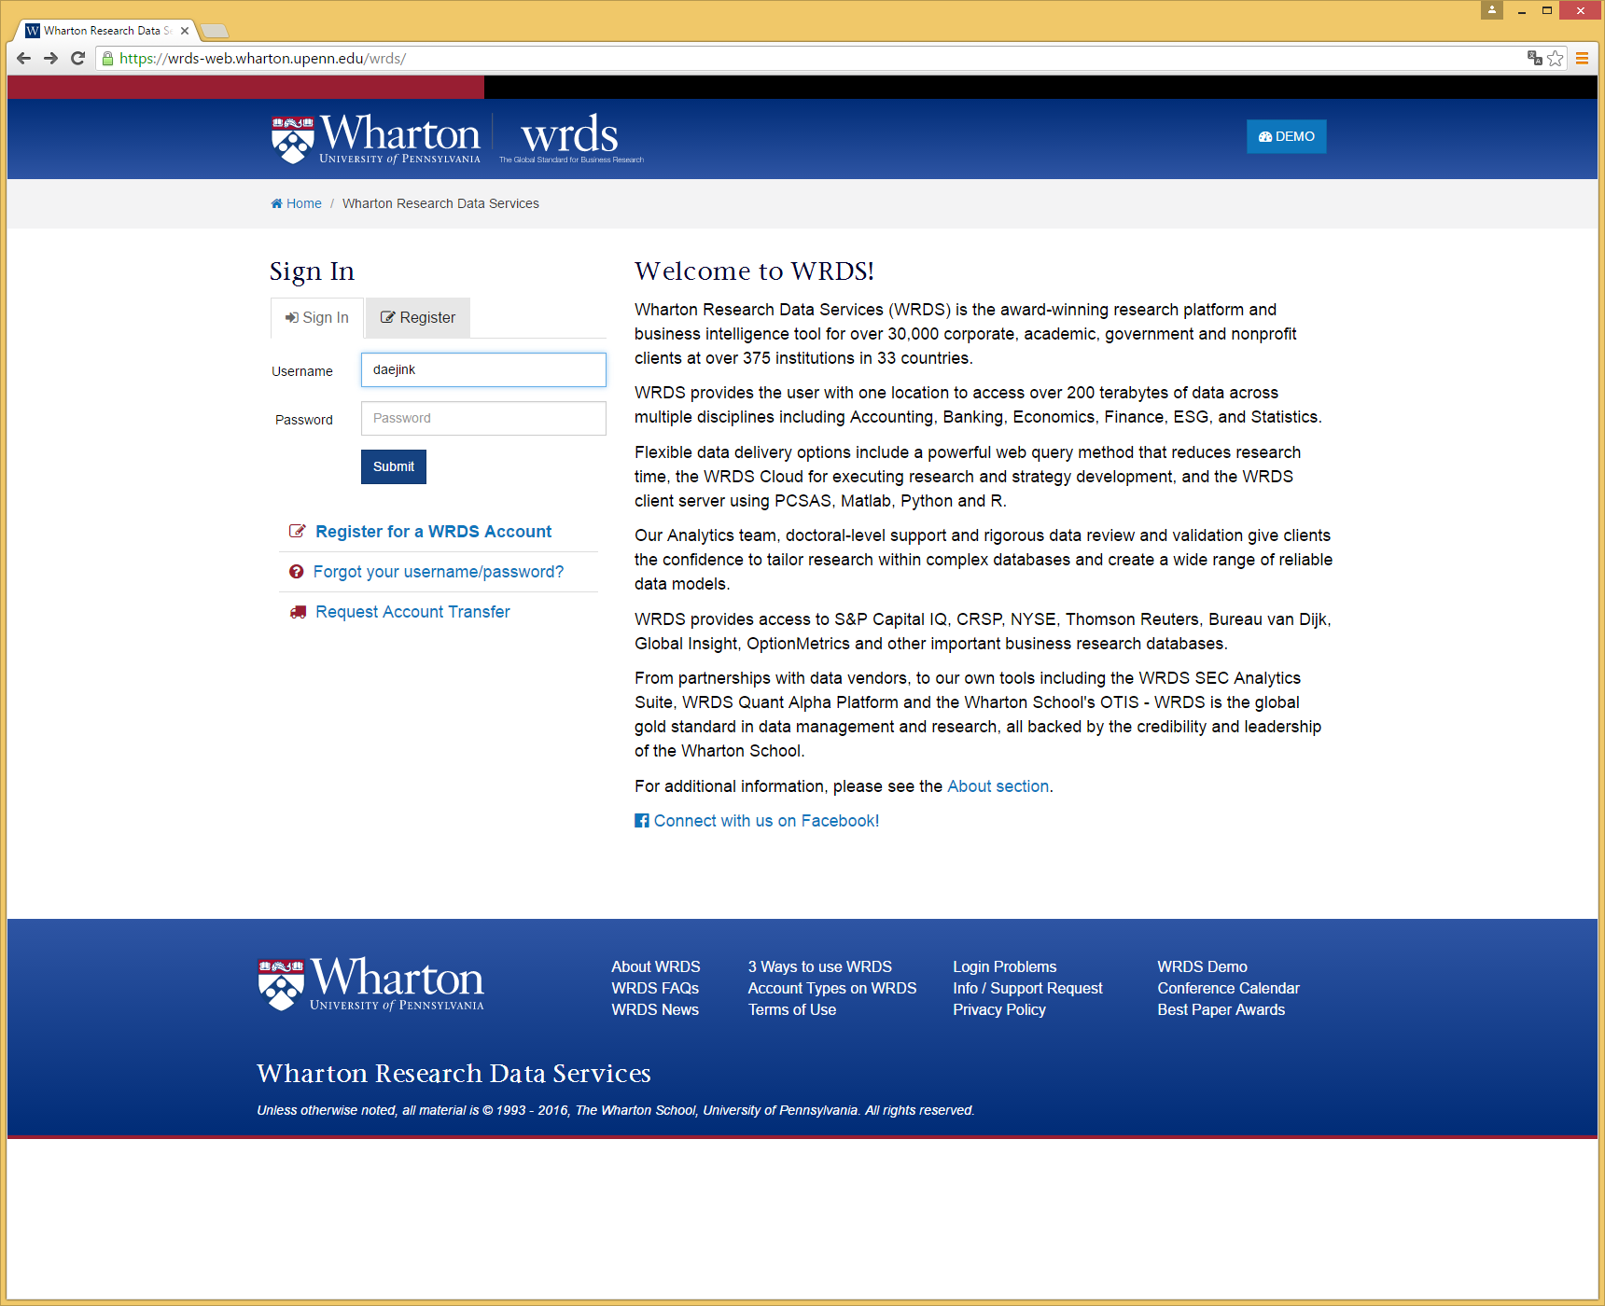
WRDS login page

Slide 10
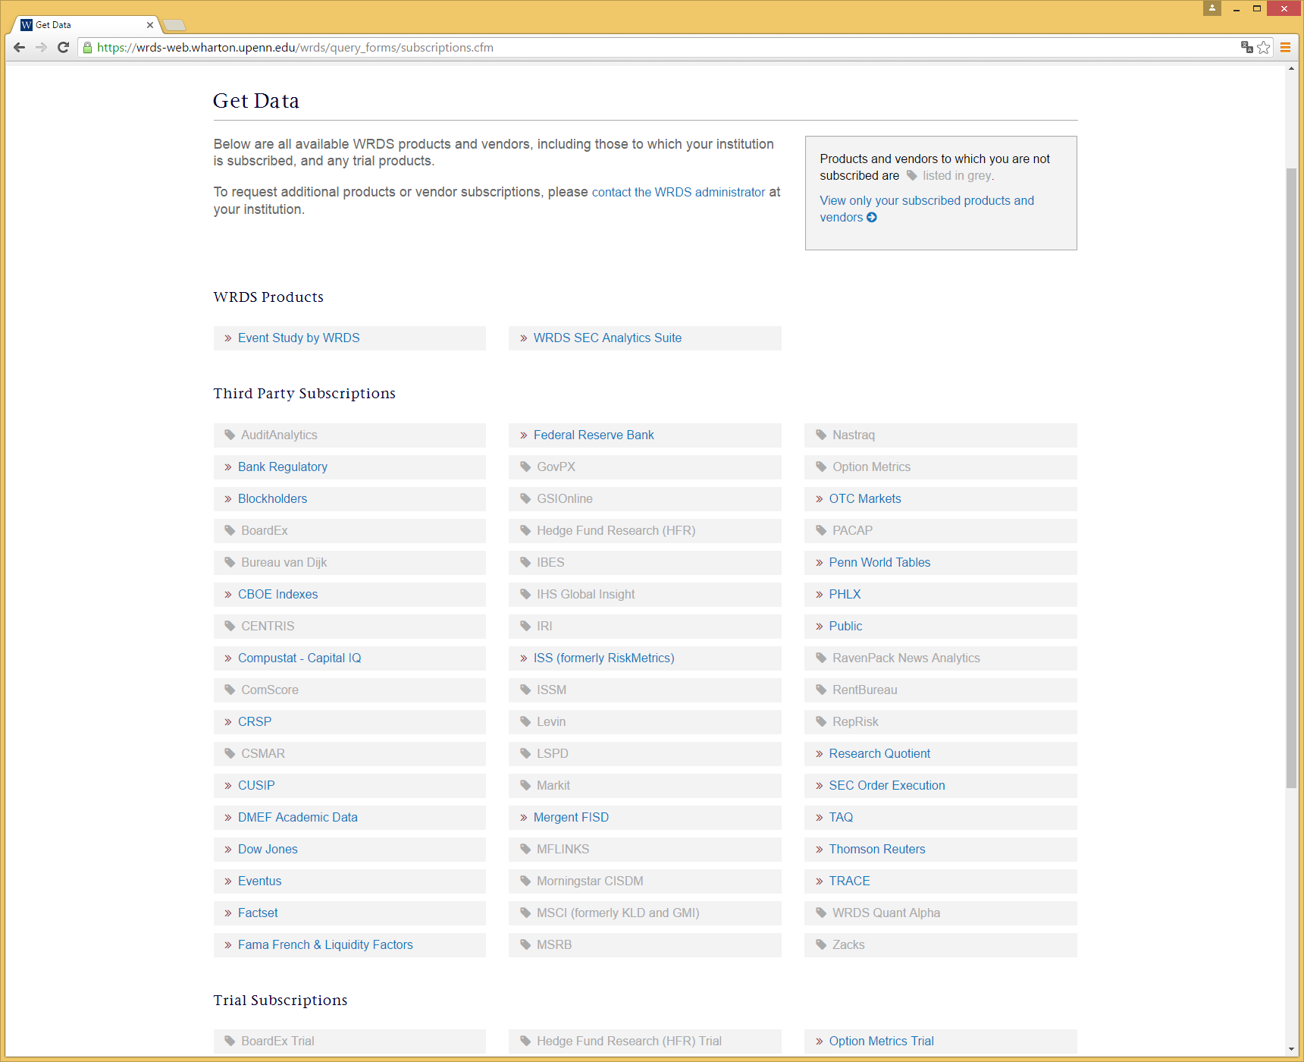
WRDS Home page (After login)

Slide 11
Let’s retrieve stock price data
We want to download the daily stock prices for IBM (IBM:NYSE), Apple(AAPL:NYSE), Amazon(AMZN:NASDAQ), and 3M(MMM:NYSE) from 3/1/2013 to 8/31/2013 (6month)
Download stock prices, daily return, trading volume, etc.
Use the CRSP database

Slide 13
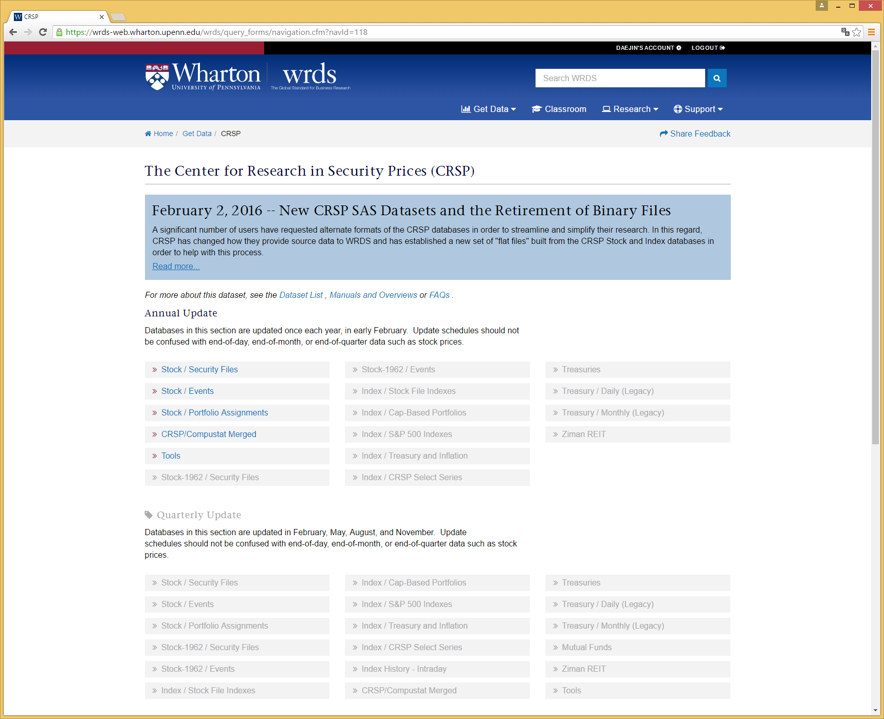

Slide 14
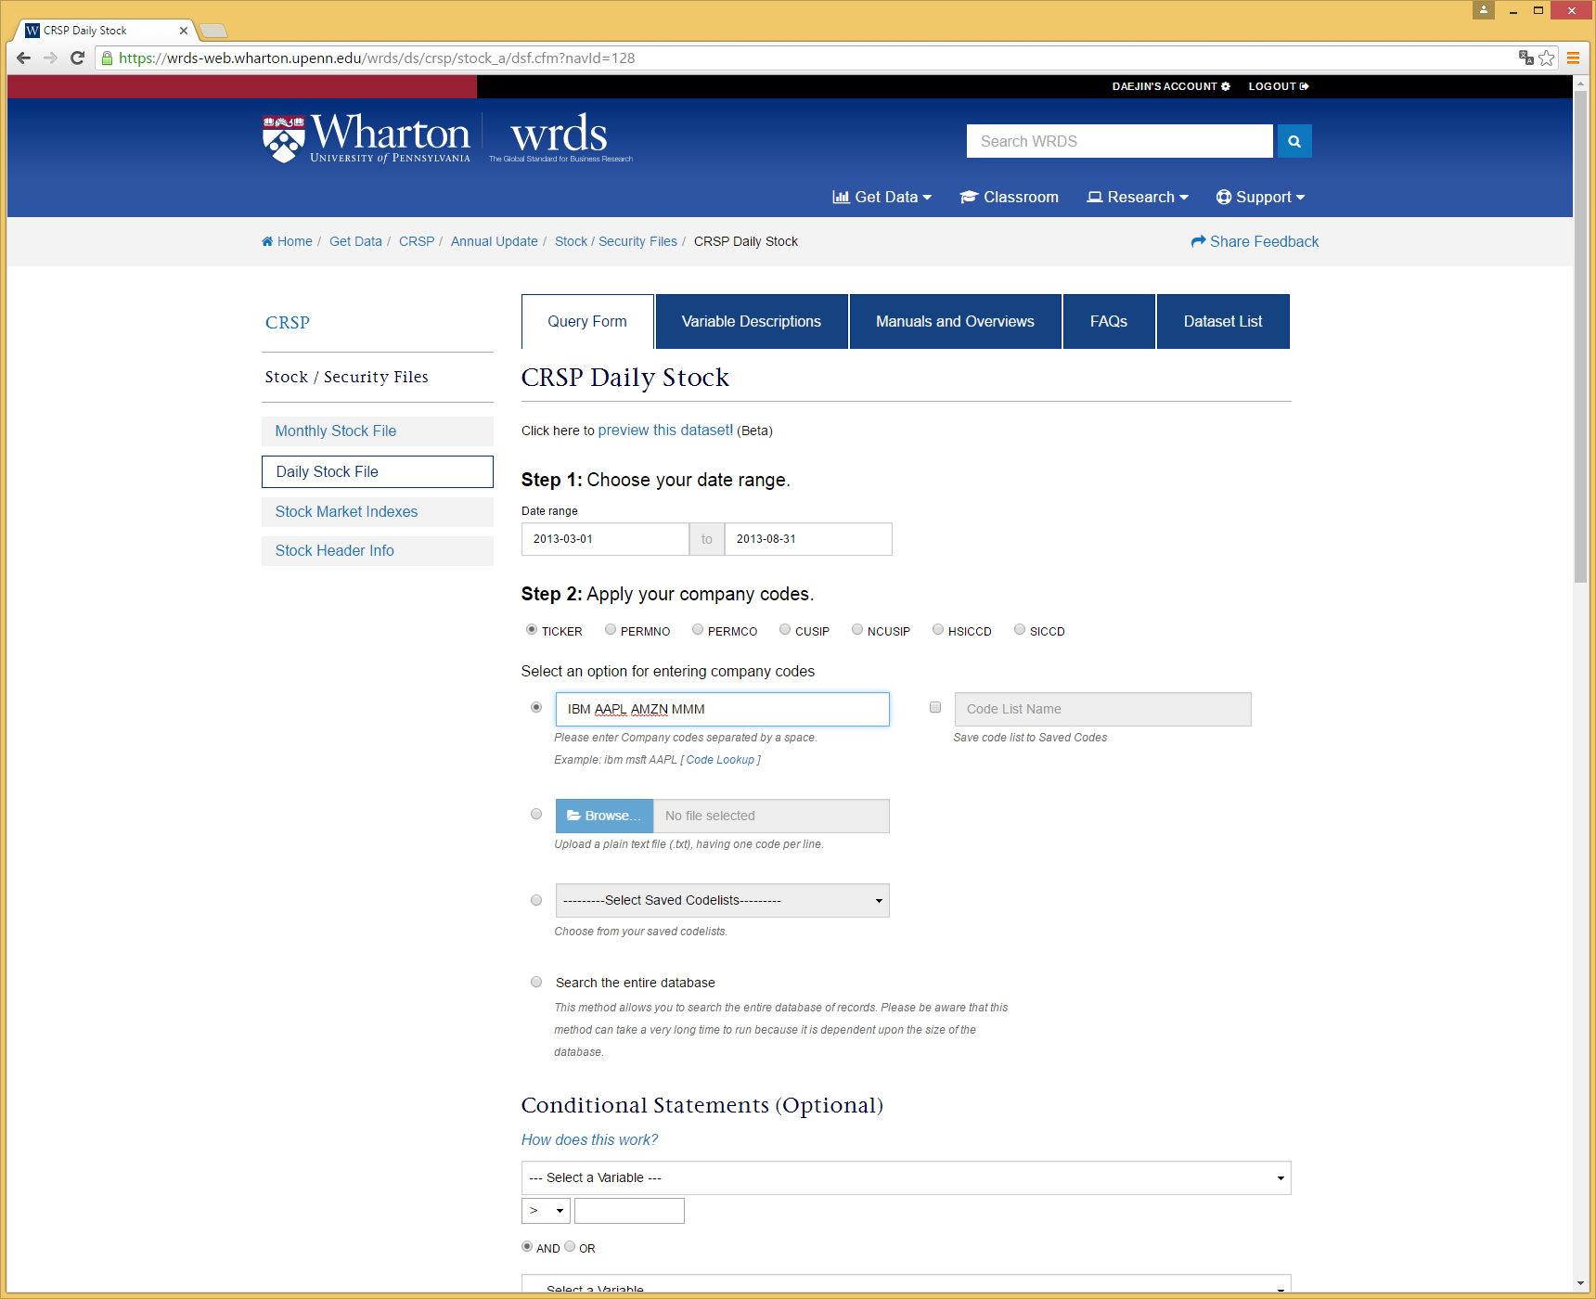
Date Range
Enter Identifiers

Slide 15
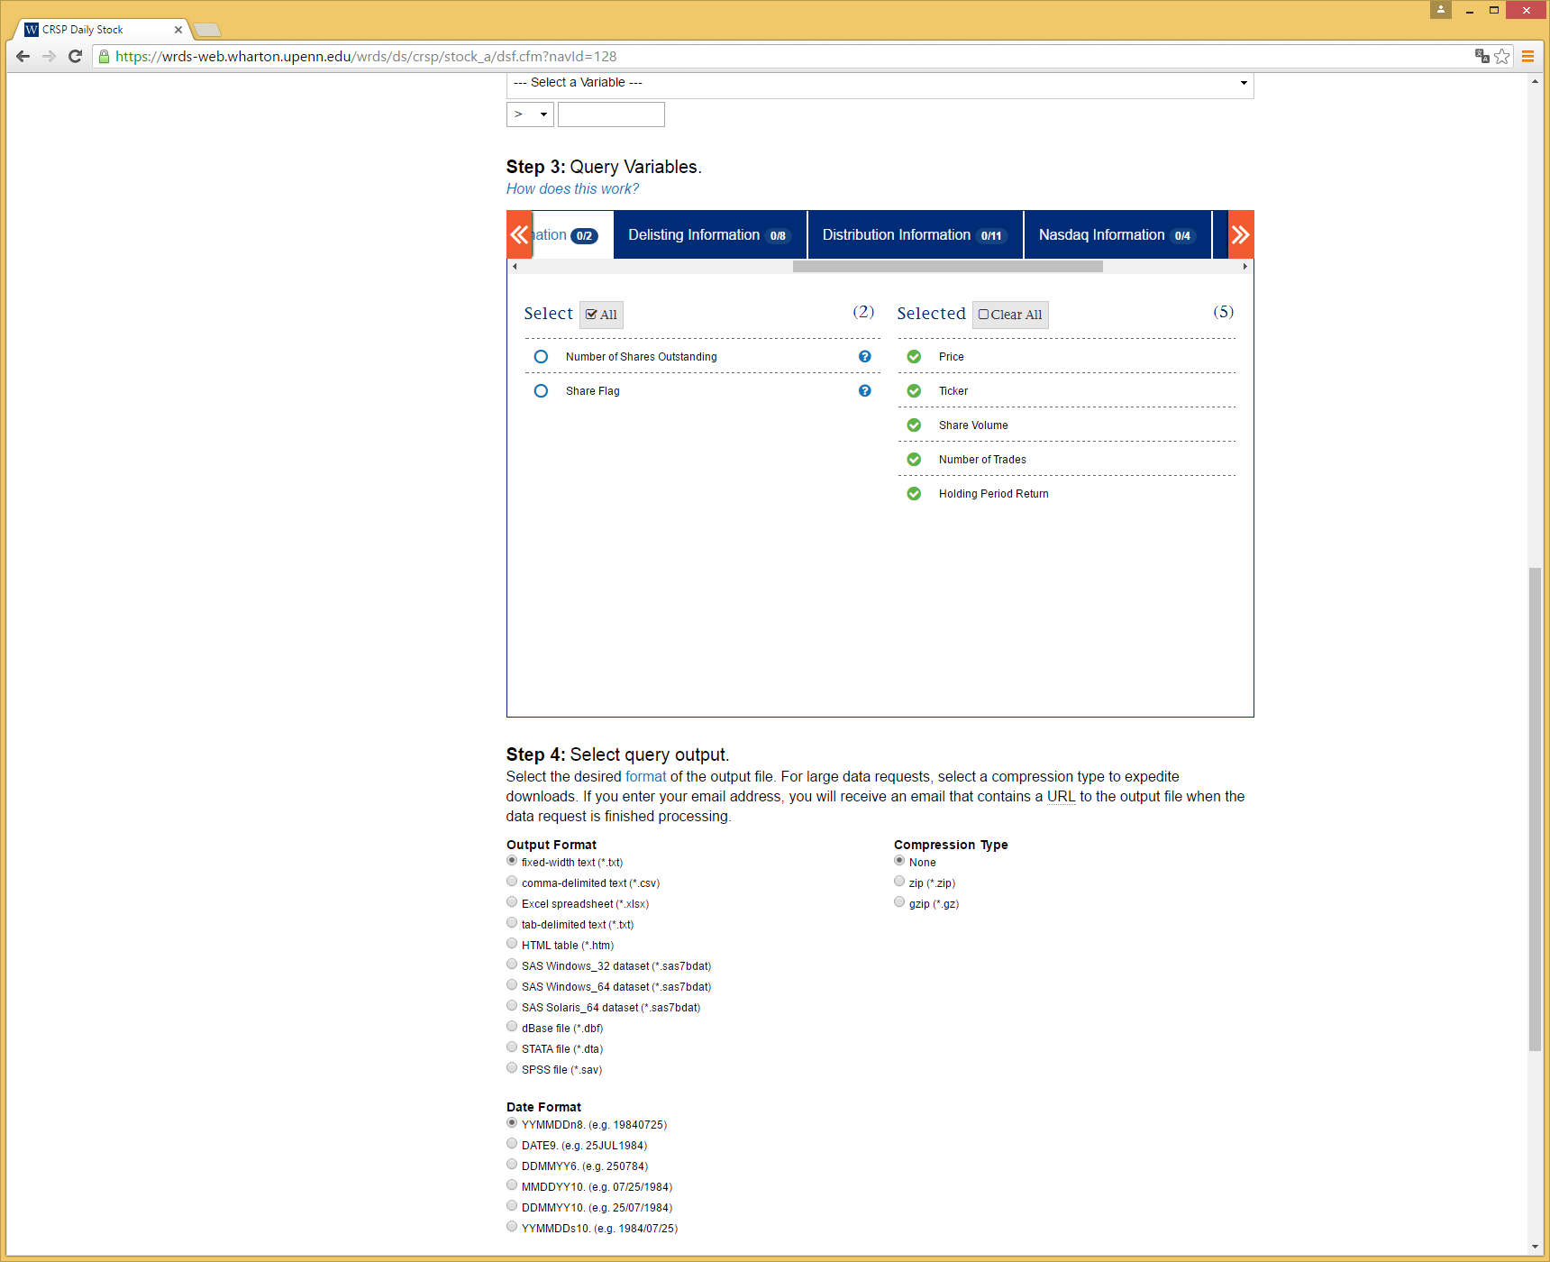
Choose Variables
Choose Data format
Text file
CSV file
SAS file
STATA file
SPSS file

Slide 16
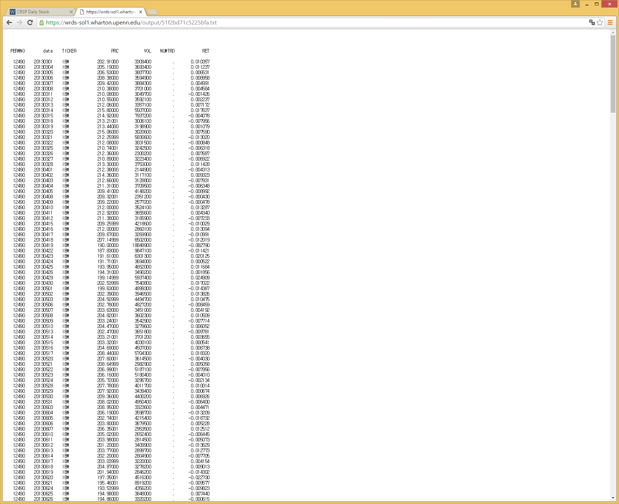

Slide 17
Web-query is convenient, but…
Not appropriate for downloading massive data
Not appropriate for combining one with another data
Alternatives
PC-SAS Connect
PC-SAS Connect requires to know some syntaxes of the SAS
You can use other program languages
MATLAB, R, STATA, Python, C, Fortran
To use other programs, you should create the SAS environment

Slide 18
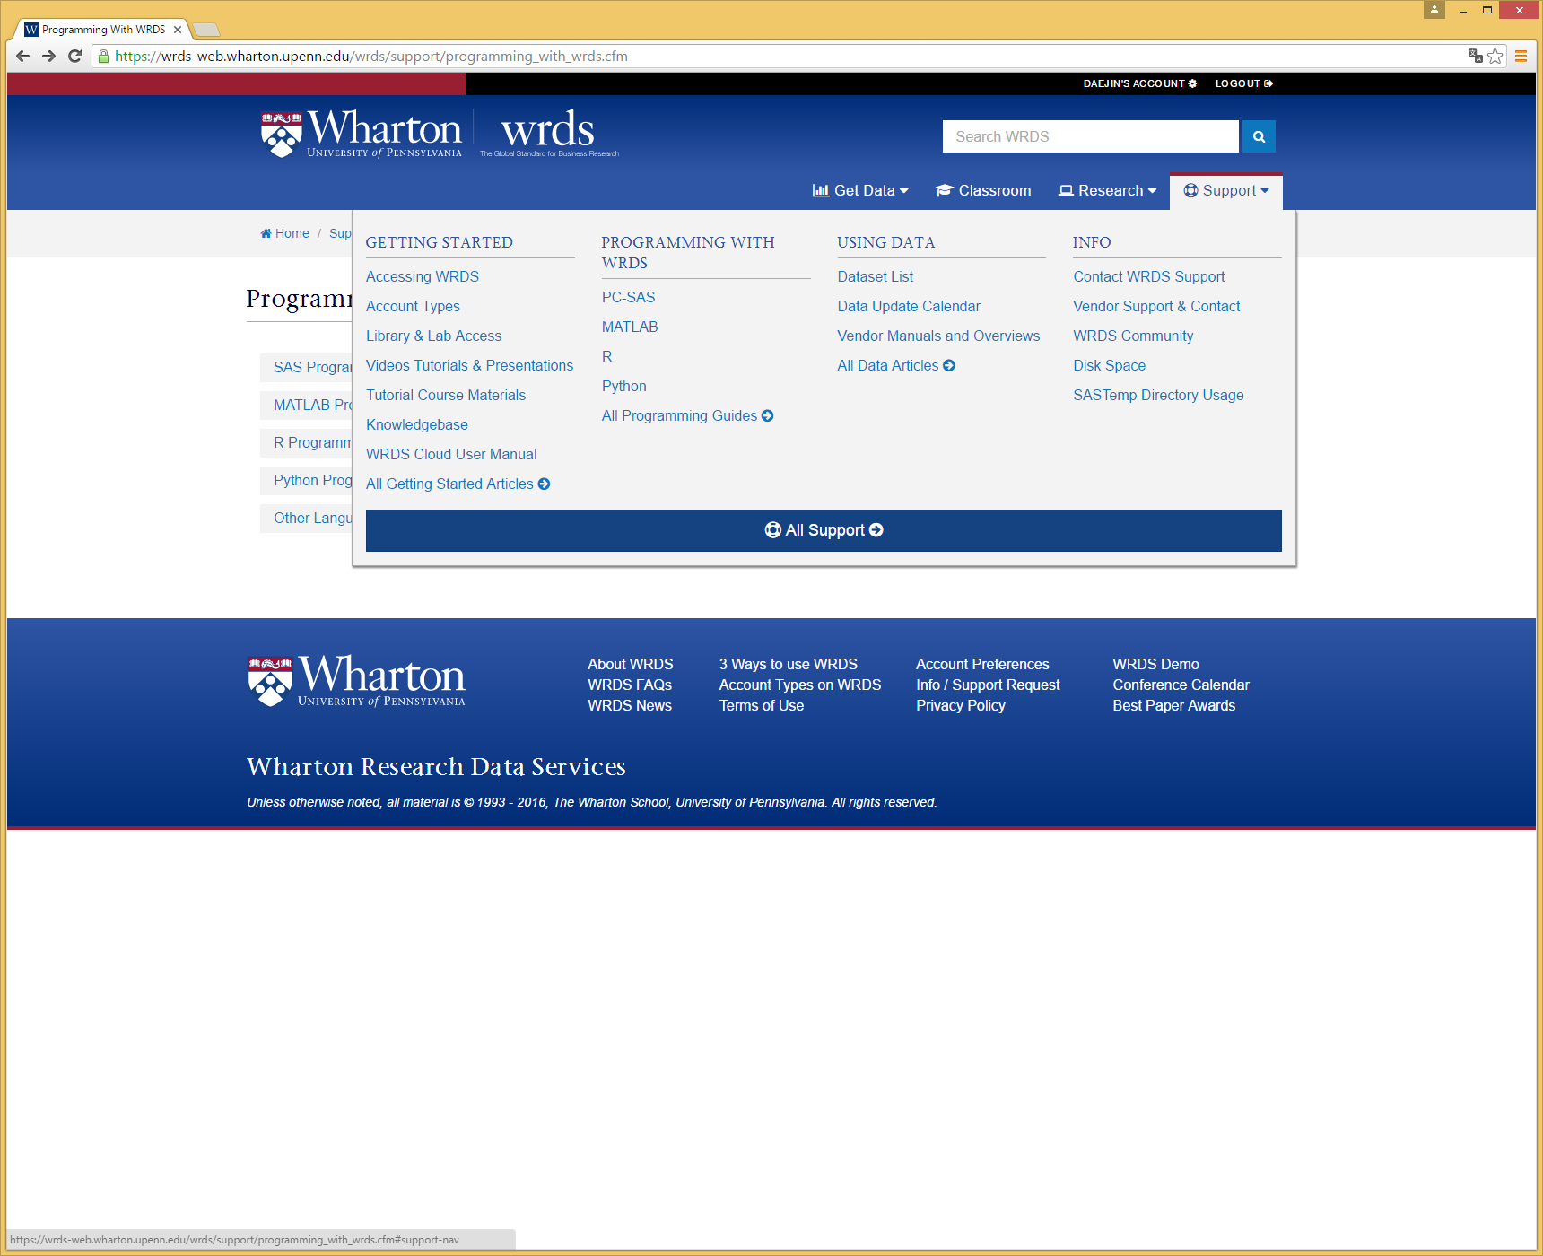

Slide 19
Sign on the Remote Server (PC SAS)
Submit this code in the editor window to sign in and establish the remote connections
%let wrds = wrds-cloud.wharton.upenn.edu 4016;
options comamid = TCP remote = WRDS;
signon username = _prompt_ password = _prompt_;
Your WRDS account name
Your WRDS account password

Slide 20
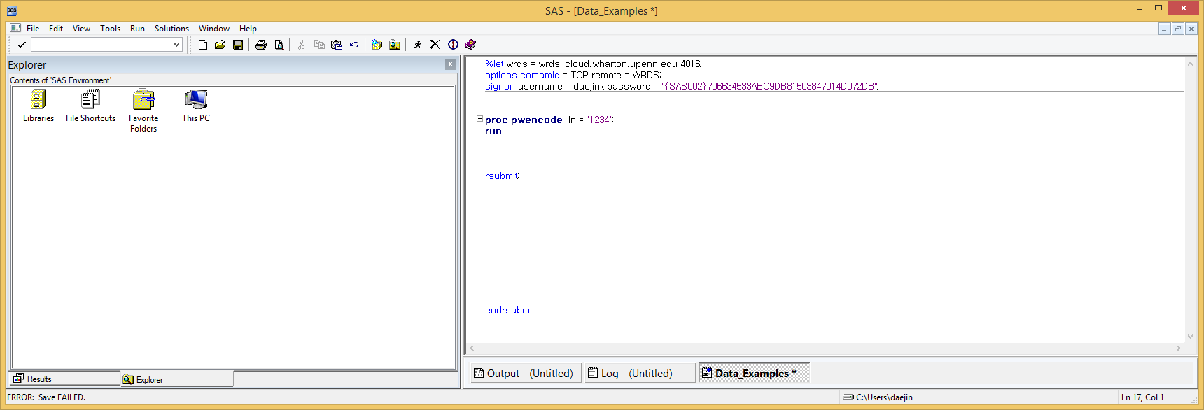
Query
All queries that you want to be executed by the remote server must be enclosed by the commands below:
Your SAS Codes

Slide 21
SAS Codes
libname crsp '/wrds/crsp/sasdata/a_stock';
proc sql;
create table temp as
select a.permno, a.prc, a.vol, a.numtrd, a.ret
from crsp.dsf as a
where permno in (12490, 14593, 84788, 22592) and (date >= '01MAR2013'd) and (date <= '31AUG2013'd);
quit;
libname crsp '/wrds/crsp/sasdata/a_stock';
data temp;
set crsp.dsf;
where permno in (12490, 14593, 84788, 22592) and (date >= '01MAR2013'd) and (date <= '31AUG2013'd);
keep permno prc vol numtrd, ret;
run;

Slide 22
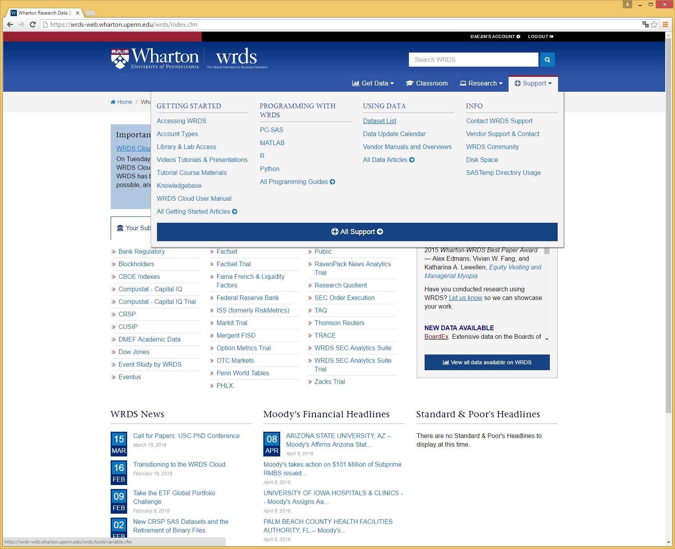

Slide 23
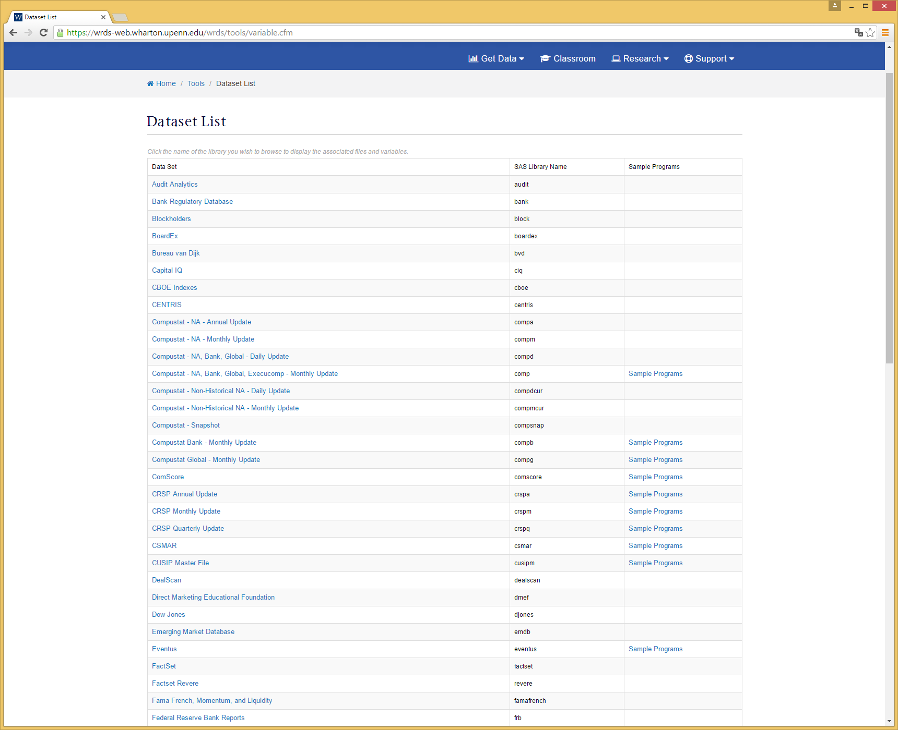

Slide 24
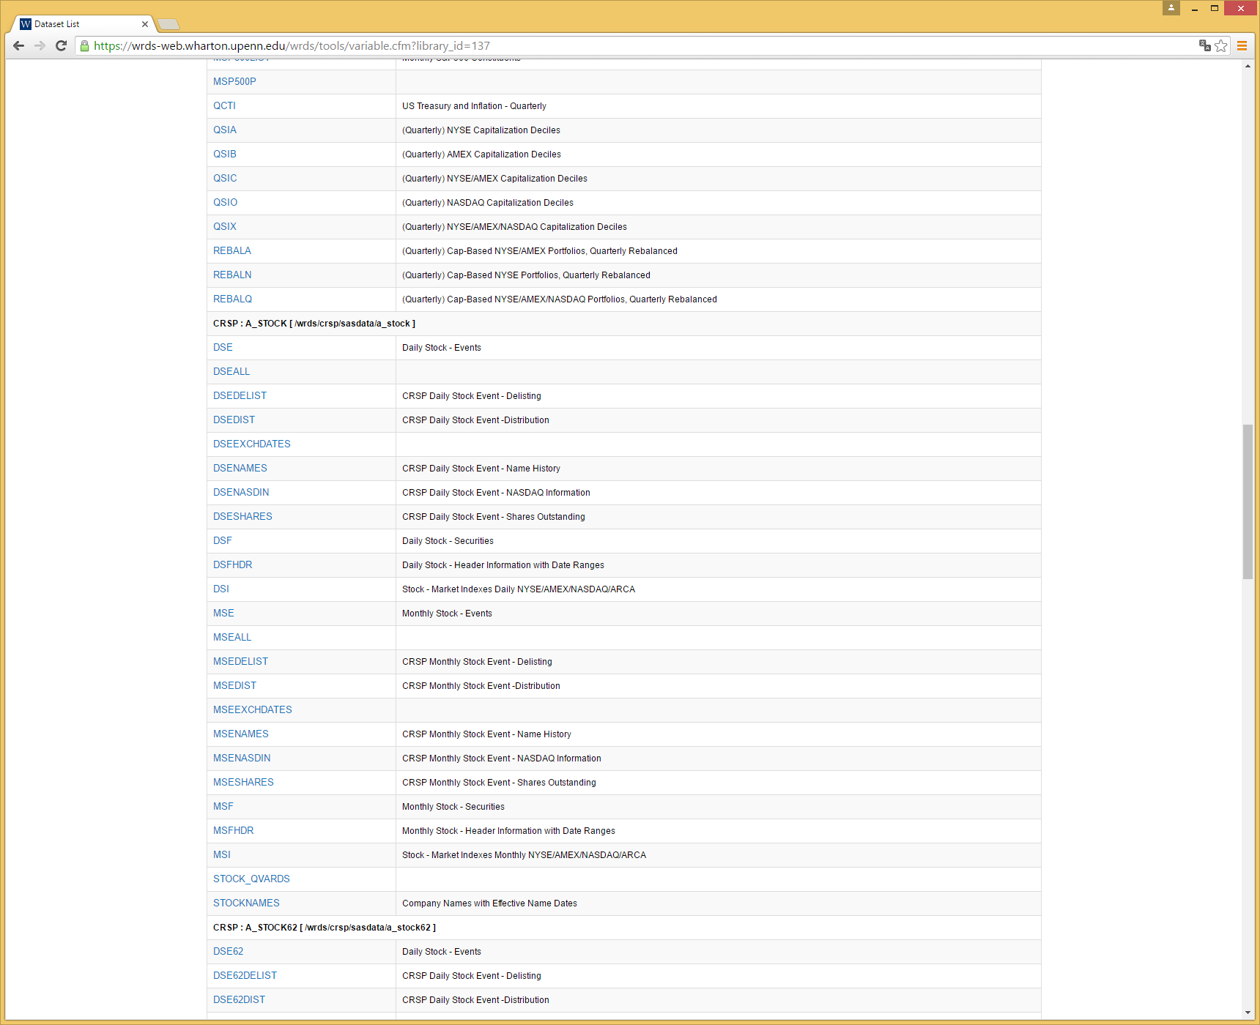

Slide 25
Another way to use the WRDS (WRDS via Unix)
You can run your sas codes with several sources at once
750 MB of disk space in your own directory
Access up to 2TB of temporary disk space to access programs
By using a Secure Shell Client(SSH) and a terminal application to log onto WRDS, you’ll be able to securely accessing WRDS data and program in SAS, FORTRAN, or C
This method requires knowledge of Unix commands, as well as an understanding of programming languages

Slide 26
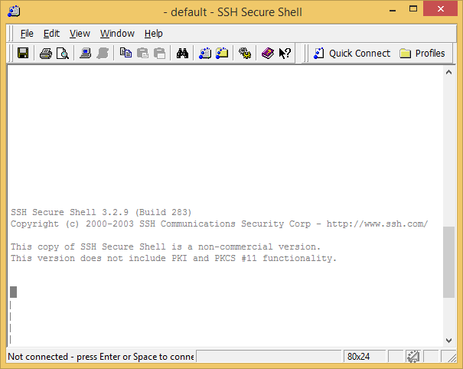
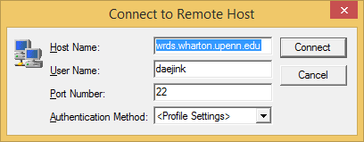
WRDS Connections via SSH

Slide 27
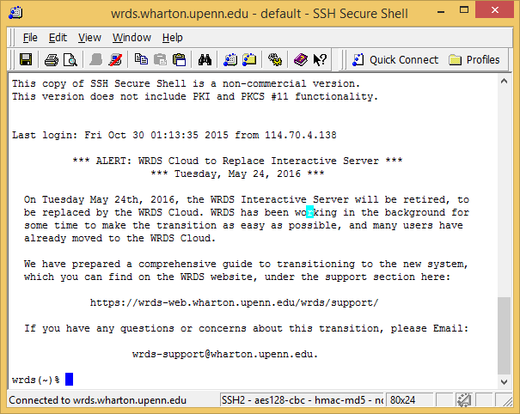

Slide 28
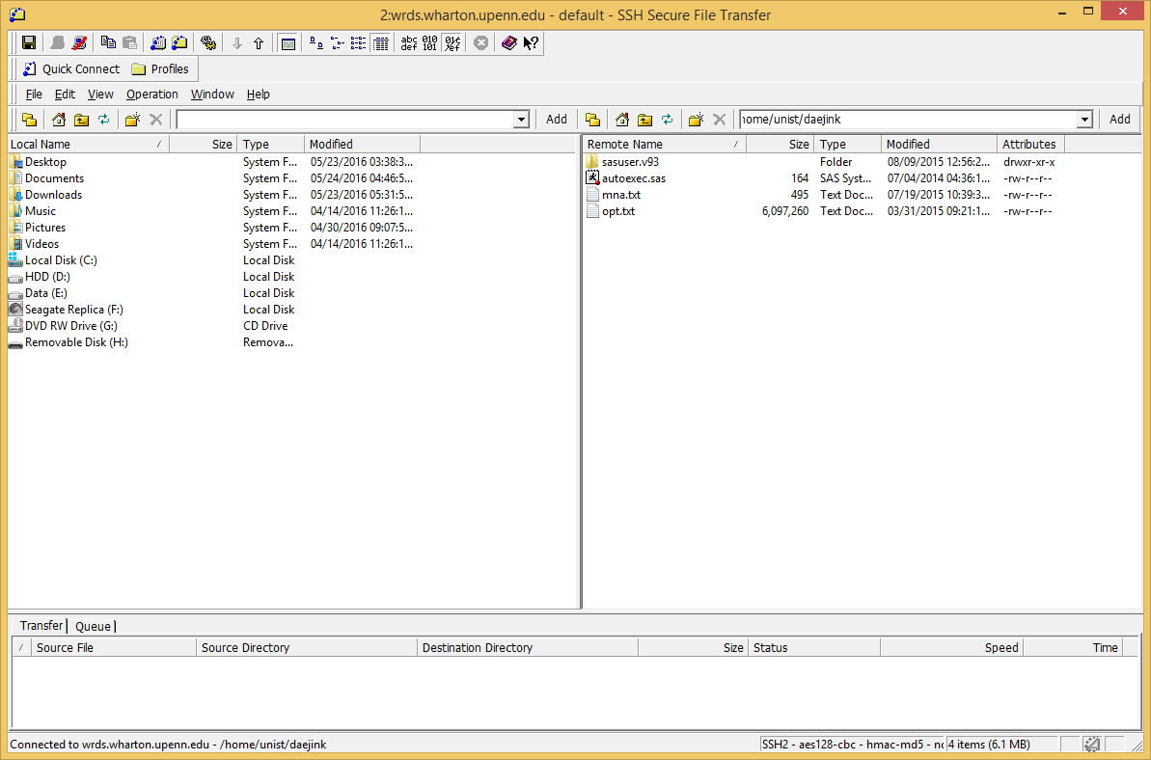

Slide 29
Unix Access
You can submit multiple SAS jobs
You are able to check data size or data locations
For more details, see
https://wrds-web.wharton.upenn.edu/wrds/support/Accessing%20and%20Manipulating%20the%20Data/_002Unix%20Access/index.cfm

Slide 30

Identifiers

Slide 31
Identifiers
Identifiers are values that correspond to an entity or security
Identifiers are useful to
Filter Data
Merge datasets
Track entities or securities through time
Header vs. Historical Identifiers
Headers are the most current identifiers
Historical identifiers have date ranges in which they are valid
Understand which type of identifier your data uses
Issue vs. Company specific
Understand if the identifier corresponds to the security or entity within your data
Date Range of different datasets
Understand if data ranges are associated with the identifiers or dataset

Slide 32
Identifiers
Universal Identifiers
Company Name
CUSIP
Proprietary Identifiers
CRSP Permno / Permco
Compustat GVKEY
Ticker
SEDOL
ISIN
CIK
Capital IQ Company ID
IBES Ticker
Option Metrics Security ID/Option ID
Markit RED Code
Factset Entity ID/ Perm Sec ID

Slide 33
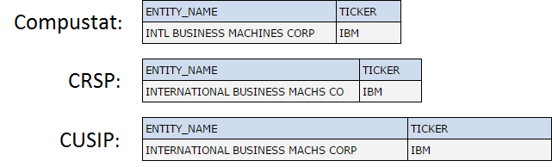
Company Name
Character String
Often abbreviated or manipulated by the data vendors causing different variations

Slide 34
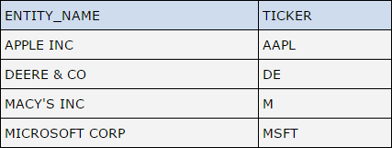
Ticker
Widely used and frequently recognizable
Can change at any time and can be reused by a different company
One company can have multiple tickers
Usually 3 or 4 characters

Slide 35
CUSIP
Committee on Uniform Securities Identification Procedures
Widely used in databases to identify securities in USA and Canada
Changes infrequently and never reused
Not free. A CUSIP license should be purchased
Can be 6,8, or 9 characters

Slide 36
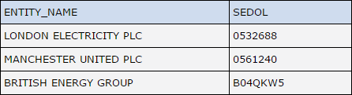
SEDOL
Stock Exchange Daily Official List
Used for identifying securities in the UK
Consists of 7 alphanumeric characters

Slide 37
ISIN
International Securities Identification Number
Used for identifying securities from all countries
Consists of 12 alphanumeric characters
Country
Of Origin
Unique
Characters (3-11)
Check
Digit
BR BHGRACNOR 9
For USA, these correspond to the CUSIP identifier

Slide 38
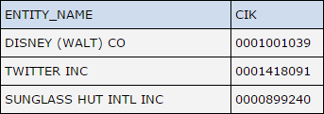
CIK
Central Index Key
Used to identify corporations and individual people who have filed disclosures with the SEC
Ten digit number
Rarely changes and never reused

Slide 39
Choosing an identifier
Proprietary identifiers can be efficient and precise when working with one data set
Ranked from less precise to more precise
Name or Ticker
CUSIP
SEDOL or ISIN for non-US companies
Data Vendor’s unique identifiers (Proprietary identifiers)
Permno, Gvkey, REDCODE, …..
Universal identifiers should be utilized to merge separate data sets
CUSIP or ISIN can be most effective
Use ticker or company names as a last resort, or use with specific dates

Slide 40
CRSP
NSUSIP
Ticker
Compustat
GVKEY
CNUM
CIC
SDC
Dealno
CUSIP
Ticker
IBES
IBES Ticker
CUSIP
IDSUM
Option Metrics
Option ID
Security ID
Ticker
OFTIC
Permno
Capital IQ
Company ID
Markit
CIK
Factset
Redcode
Ticker
Entity ID
Sec ID
CUSIP
ISIN
SEDOL
TIC
CUSIP
ISIN
SEDOL
CUSIP
Ticker
CUSIP

Slide 41
Linking by Company Name

Slide 42
Difficulties with CUSIP for Research
For e.g. Dell changed their name in July 2003
Dell Computer Corp -> Dell Inc.
The ticker remained DELL but the CUSIP changed
Before Name change CUSIP : 24702510
After Name change (from 7/22/2003) it was 24702R10
CUSIPs have only existed since the late 1960s
We can’t use to match for earlier data

Slide 43
Companies Change Over Time

Slide 44
Best Practices : Understand Your Data
Header vs. Historical Identifiers : understand the nature of the data
Do you databases have “Names” datasets: Mappings between proprietary identifiers and universal identifiers
Issue vs. Company specific : relaxing the mapping conditions accordingly (e.g. 6-digit CUSIP vs. 8-digit CUSIP)
Always use Multi-step approach
Link Table
Merging
Periodicity of different datasets : do not assume same date/time frequencies, test it, and use flexible joins

Slide 45
Best Practices : Rules and Definitions of Universal Identifiers
Tickers, 8-digit CUSIPs, and ISINs identify securities. 6-digit CUSIP is company specific. Ticker is assigned by exchange. CUSIP by S&P CUSIP bureau. ISIN is 12-digit identifier based on CUSIP for US companies. ALL can change over time
Stock tickers are exchange specific, have suffixes, can change, and often are reused.
Rule : Always use tickers with dates (and exchanges) in linking
CUSIPs and ISINs also change but are NOT recycled
Rule: Most effective Linking. Use entire 8-digit CUSIP or 12-digit ISIN to link issue-specific data (price, volume, EPS,…)
Rule : CUSIP and ISIN issue identifiers are not exchange-specific

Slide 46
Best Practices : Rules and Definitions of Universal Identifiers
CIK is the Company’s Filing Number at the SEC, and can change
Rule : Use GVKEY-CIK Link Table in WRDS, to track all filings of a certain company
Neither ticker, CUSIP, ISIN, or CIK may identify a M&A/Restructuring path for a company /security
Company names are often abbreviated/manipulated by data vendors
Rule : Very difficult to write a reliable merging program using company names
Lost links, unlinkable cases, and wrong links create survivorship biases

Slide 47
Most research use CRSP Permno/Permco or Compustat GVKEY
CRSP Permno/Permco (5 digit number)
Permno identifies securities
Permco identifies companies
Permno and Permco do not change when a company changes their name or ticker
Never Reassigned
Compustat GVKEY (6 digit number)
GVKEY represents a company
GVKEY is mapped to the most recent ticker, company name
GVKEY doesn’t change through the life of a company

Slide 48
Examples of unique identifiers

